Slide 1
Using Kubernetes APIs from Go
Alena Prokharchyk, Software Engineer, Rancher Labs Twitter: @lemonjet

Slide 2
Why we all love Kubernetes
Features richness
Designed to handle big workloads
Robust releases
Community
Extensibility (API aggregation, Custom Resource Definitions, Container Runtime Interface)

Slide 3
Extensibility makes Kubernetes a platform
Core features’ set can be extended by third parties
New user facing APIs can be plugged
Custom controllers can be written to provide more functionality

Slide 4
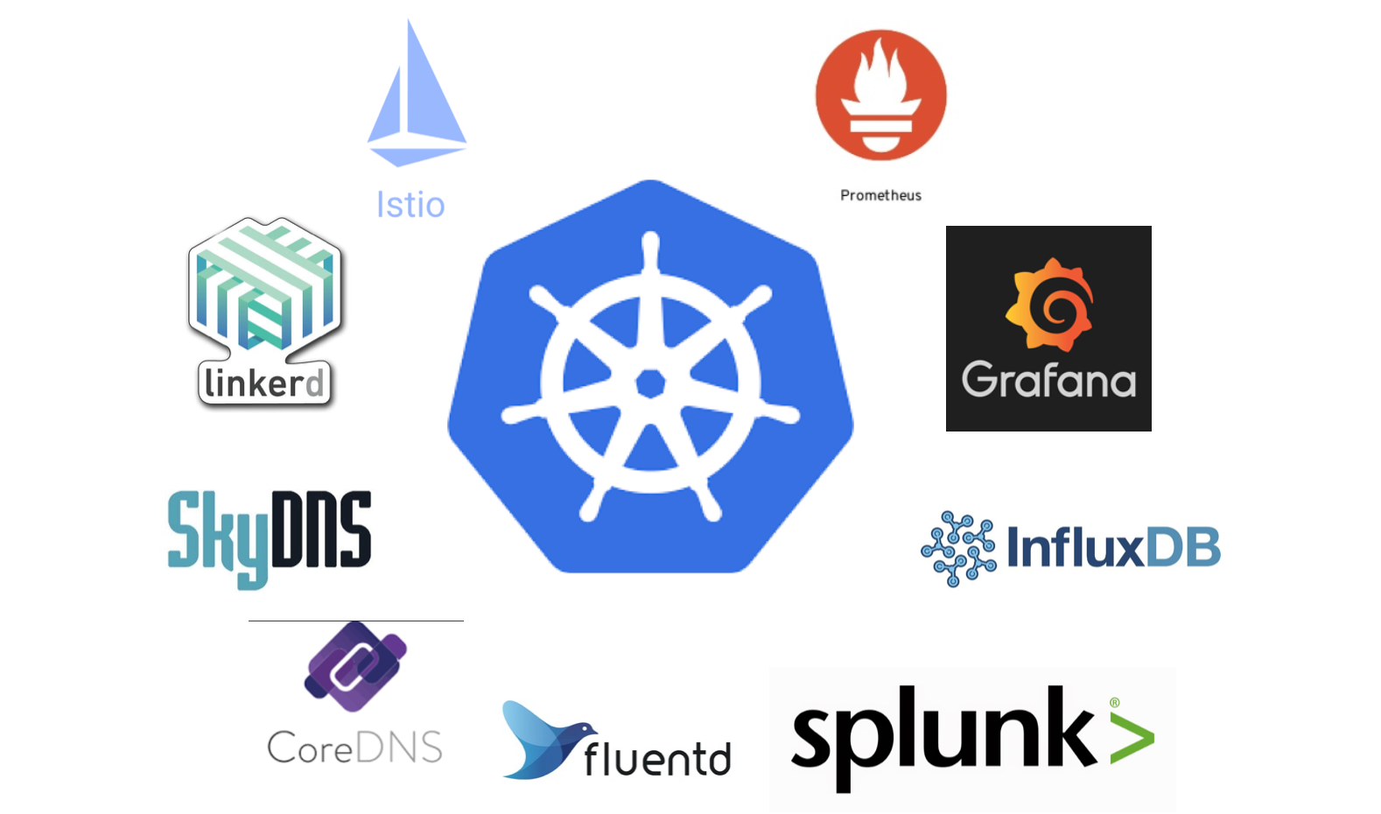
Kubernetes ecosystem
Content
Content
Content

Slide 5
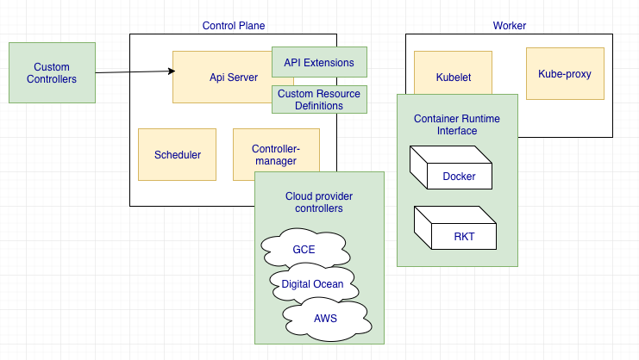
Ways to extend Kubernetes

Slide 6
You will hear term “controller” a lot…
The most common definition: “Code that brings current state of the system to the desired state”
Example: Ingress controller
Monitors ingress resource by talking to k8s APIs
Configures external LB
Updates ingress resource with the LB address

Slide 7
Ways to talk to Kubernetes API
Dashboard
kubectl
Programmatic access: calling k8s APIs

Slide 8
Clients
Go: https://github.com/kubernetes/client-go
Python: https://github.com/kubernetes-incubator/client-python
Java: https://github.com/fabric8io/kubernetes-client
And many more: https://kubernetes.io/docs/reference/client-libraries/

Slide 9
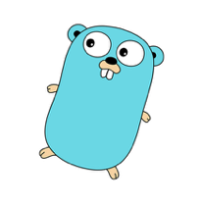
We chose Go client, because…
Kubernetes written in go implies faster updates for client-go bindings
Language simplicity
Static linking support

Slide 10
Lets build…
A tool that:
Monitors k8s nodes
Alert when storage occupied by the images, changes
https://github.com/alena1108/kubecon2017

Slide 11
Toos used for demo project
go-skel: Go project skeleton tool(https://github.com/rancher/go-skel)
trash: Go ./vendor dependencies manager (https://github.com/rancher/trash)
dapper: Docker build wrapper for building and packaging an app as a container image (https://github.com/rancher/dapper)

Slide 12
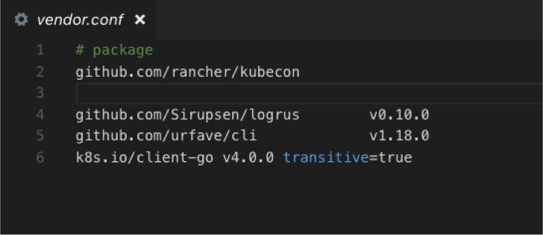
Add client-go as a vendor
Make sure its version compatible with Kubernetes server version

Slide 13
Chose the way to run the tool
Inside the cluster – runs inside the pod, managed by Kubernetes
Outside of cluster – run as an external app

Slide 14
Demo

Slide 15
Controller pieces
Authenticate
Watch for data
Take action on the data

Slide 16
Thank you!

